Slide 1
NonChord Tones 2

Slide 2
Nonchord Tones, up to now
We have covered:
Passing Tone
Neighboring Tone
Both of which are approached and left by step
The can be described as
Ascending/Descending
Diatonic/Chromatic
Accented/Unaccented
Upper/Lower

Slide 3
NCTs with leaps
Appoggiaturas
Approached by leap, left by step
Escape Tones
Approached by step, left by leap
Neighbor Groups
A note note group that contains leap that is approached a left by step.

Slide 4
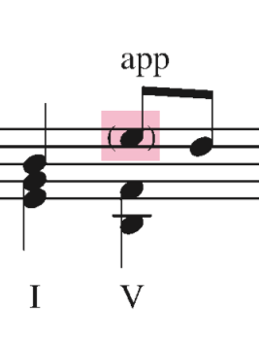
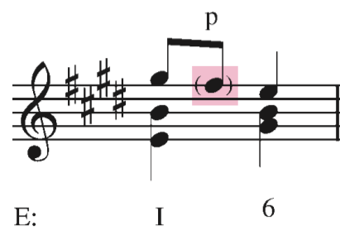
Appoggiaturas
Appoggiatura: a NCT that is approached by leap and left by step
Generally, appoggiaturas are accented and approached by an ascending leap, and left by a descending step
This is a similar melodic motion to how we dealt with large intervals when composing simple melodies at the beginning of the semester
Put the note in parentheses, and label with a app

Slide 5

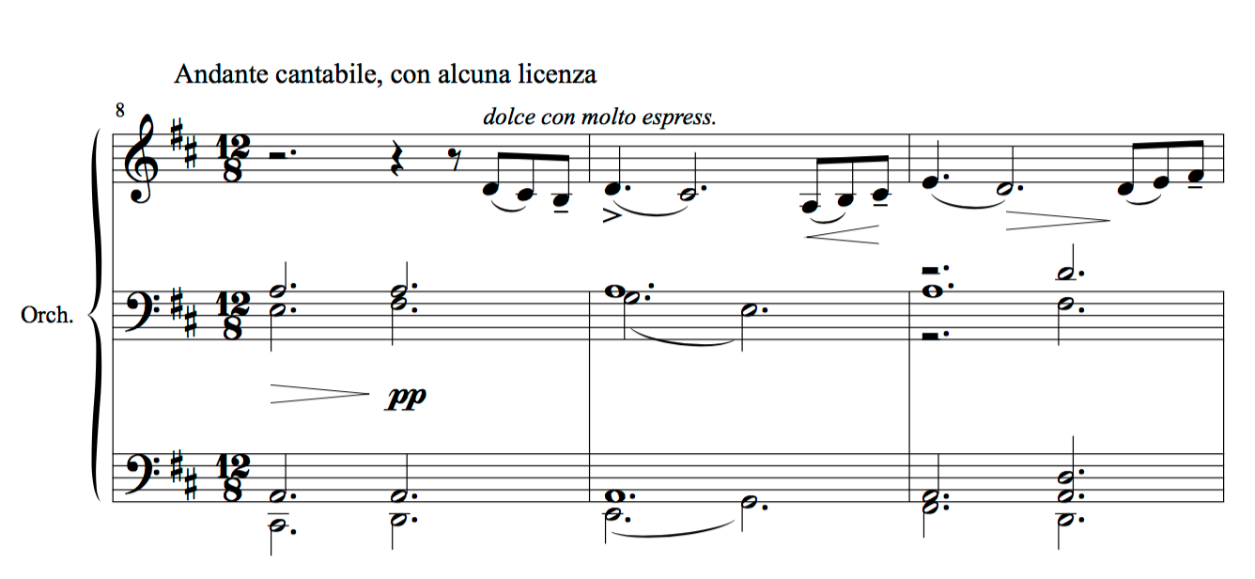
Tchaikovsky, Symphony no. 5 in e minor, op. 64, mvt. 2

Slide 6
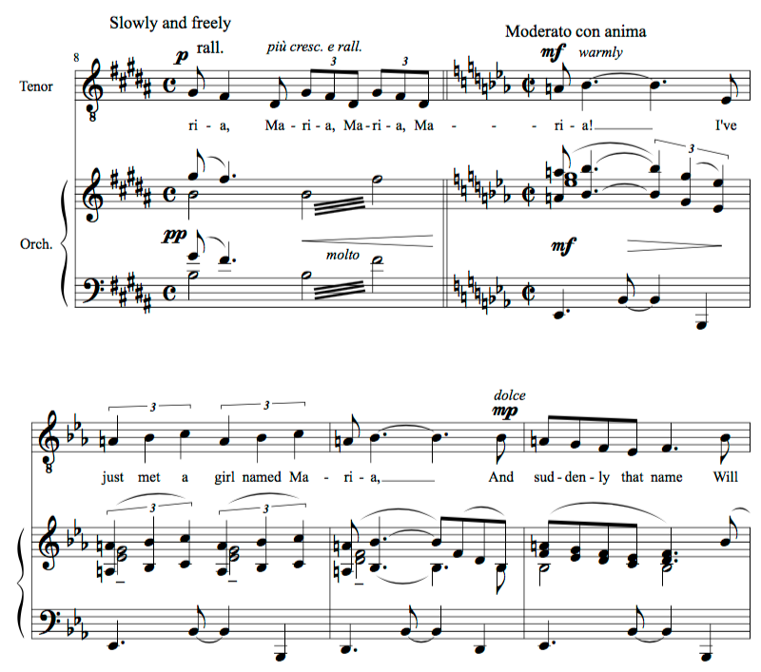
Bernstein, West Side Story, "Maria"

Slide 7
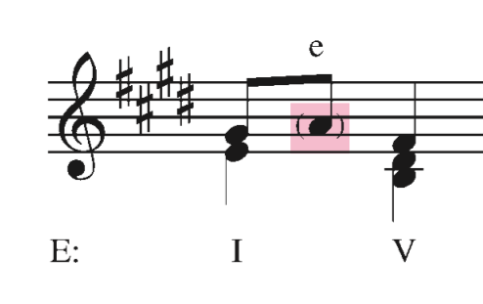
Escape Tones
Escape Tone: Approached by step and left by leap
This is the opposite of the appoggiatura
Put the note in parentheses, and label with a e

Slide 8
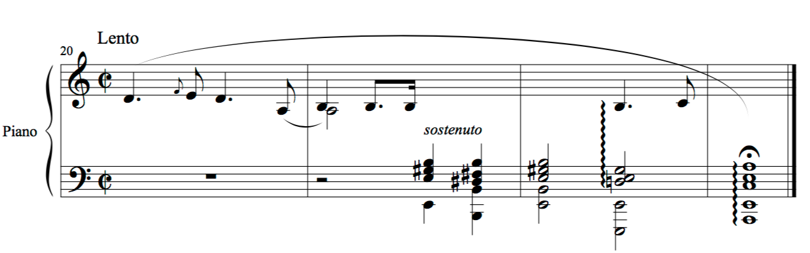
Chopin, Prelude in a minor, op. 28 no. 2

Slide 9
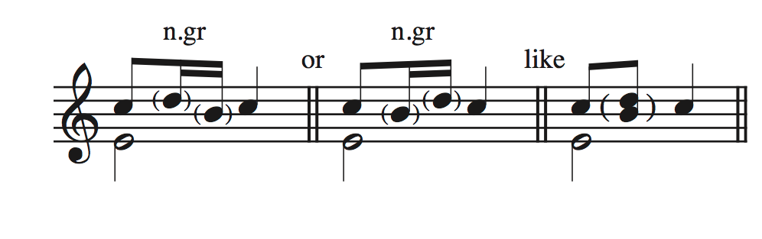
The Neighbor Group
Neighbor Group: A common method of embellishing a single tone involving a combination of two NCTs in succession, an escape tone, followed by an appoggiatura.
Labeled with an “n.gr”

Slide 10
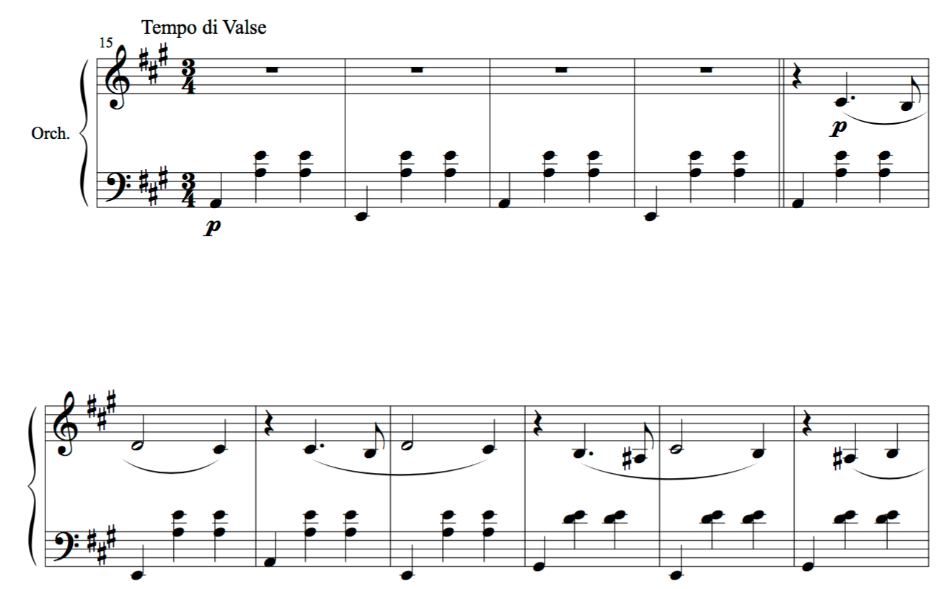
Tchaikovsky, Suite from Swan Lake, op. 20, mvt. 2

Slide 11
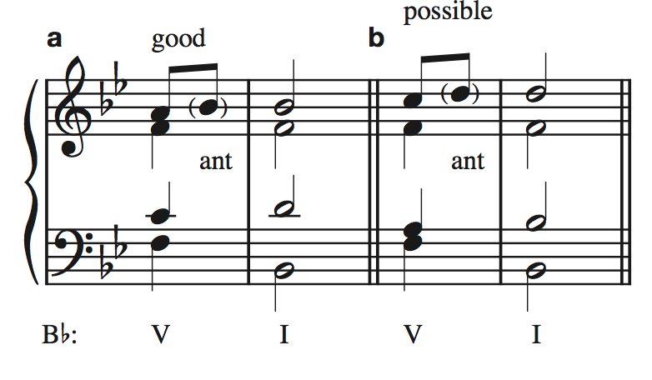
Anticipation
Anticpation: a tone that “arrives early” to the following chord
Approached by step or leap, and left by same-tone
Cannot be a member of the chord, and is ideally dissonant
Labeled with “ant”

Slide 12
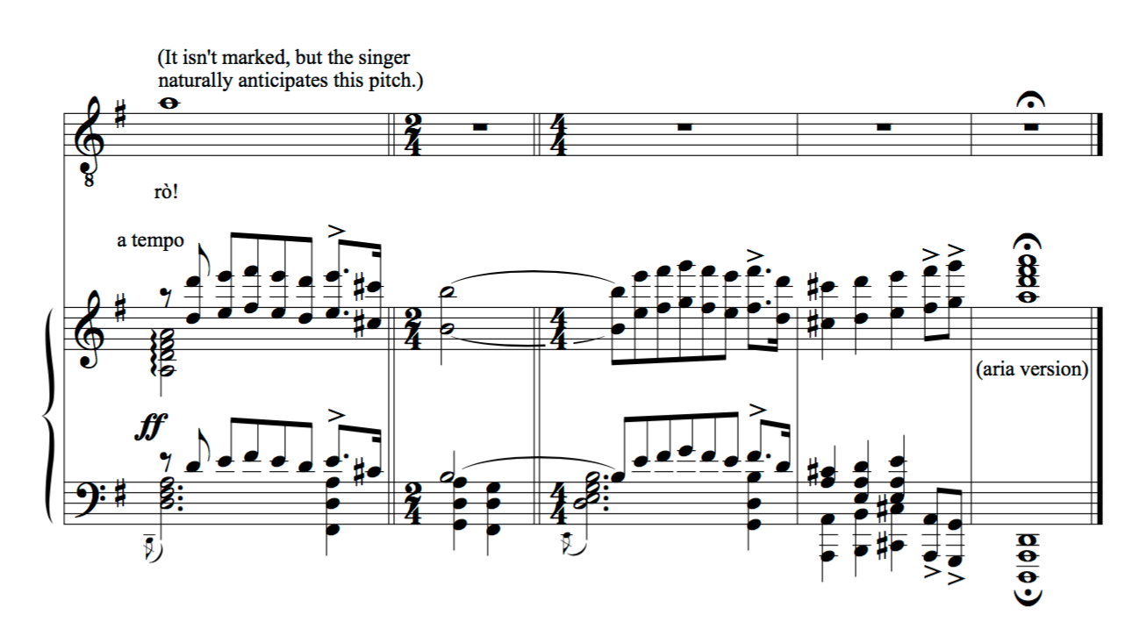
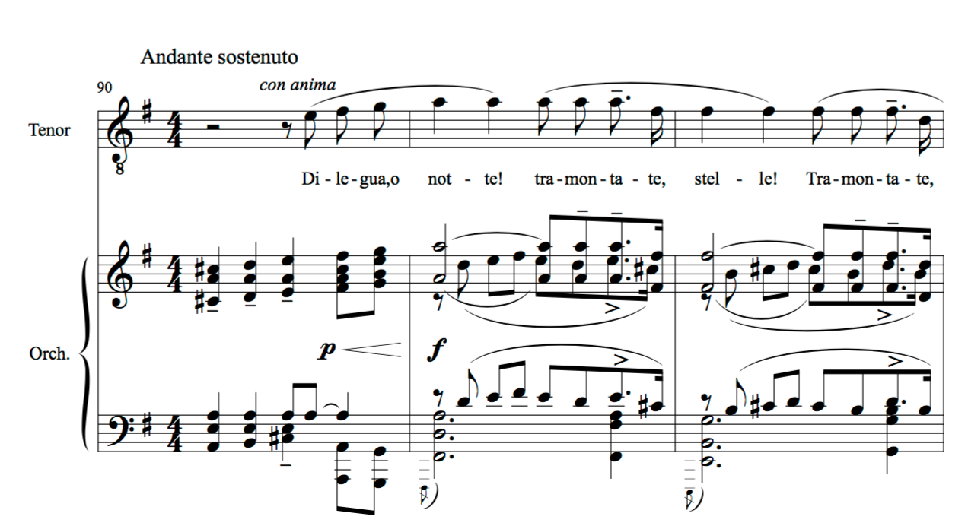
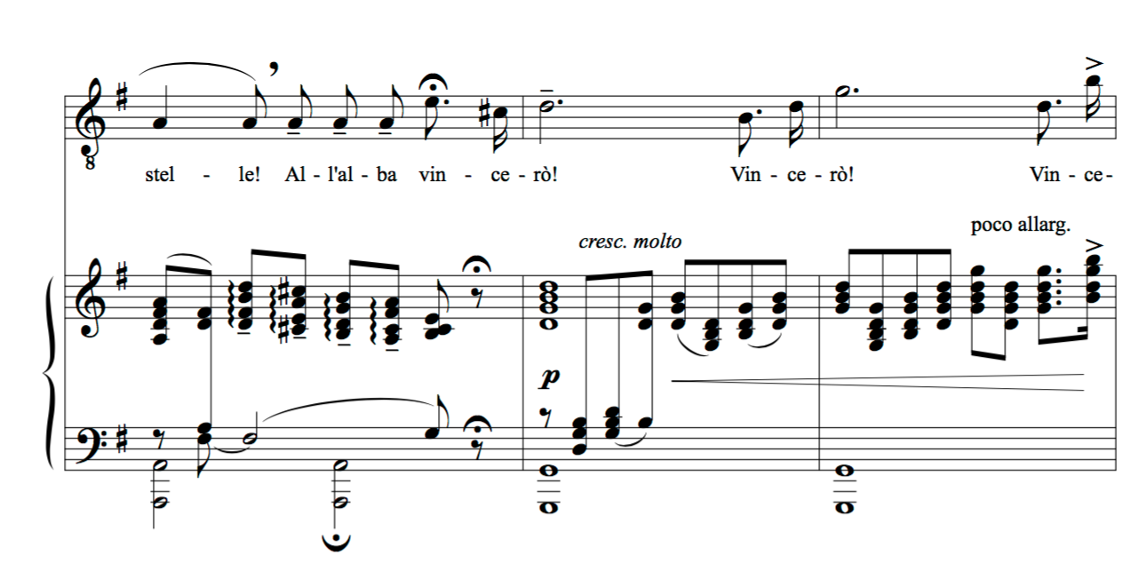
Puccini, Turandot, Act III, Nessun Dorma

Slide 13
Pedal Point
Where have we seen pedals before?
Pedal six-four chords
pedal point: a compositional device that begins as a chord tone, then becomes an NCT as the harmonies around it change, and finally ends up as a chord tone when the harmony is once more in agreement with it.
approached by same tone, left by same tone
NCTs generally embellish a harmony
but, with pedal points, the NCT has such tonal strength that it seems that the other harmonies are embellishing the pedal point.

Slide 14
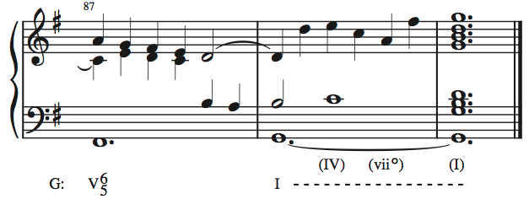
Bach, Allein Gott in der Höh’ sei Ehr

Slide 15
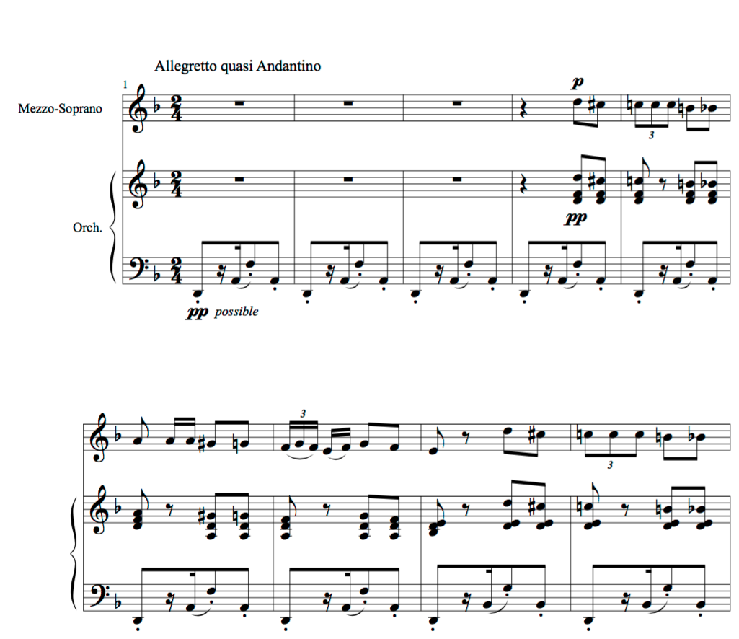
Bizet, Carmen, Act I no. 5, Habañera

Slide 16
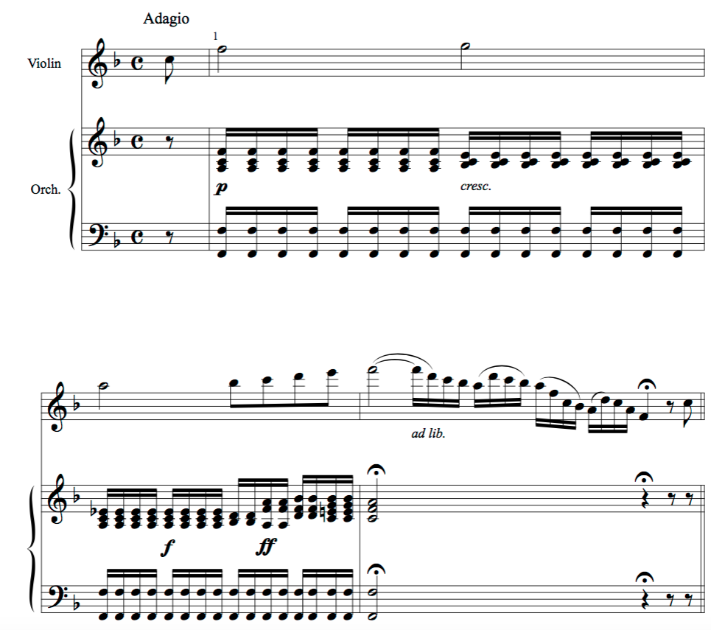
Haydn, Violin Concerto no. 1 in C Major, Hob. VIIa: 1, mvt. 2

Slide 17
Pedal Points
Inverted Pedal Points: pedal points that do not occur in the bass voice
Double Pedal Points: pedal points that contain two notes

Slide 18
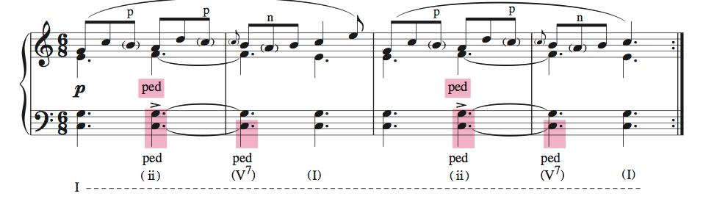
Schumann, “Reaper’s Song,” op. 68, no. 18

Slide 19
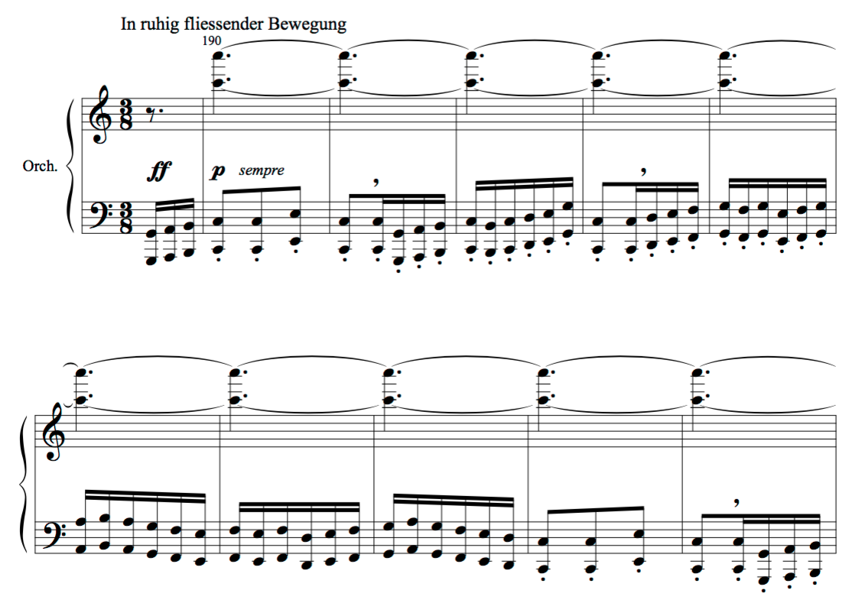
Mahler, Symphony No. 2

